Slide 1
Probe Data Analysis for Road Slope
Mohan Jayaprakash – A20405567
Herick Jayesh Asmani – A20399752
Sharanheer Choudhari – A20398615

Slide 2
Goal:
Given the input Probe data and Map.
Map match the probe points to the road links.
Derive the road slope for each road link.
Evaluate the derived road slope with the surveyed road slope in the link data file.

Slide 3
Overview
Probe Data:
It is the data which is generated by monitoring the position of moving objects over space and time. These moving objects can be dedicated vehicles, cellular phones, etc. used to collect information.
It consists of information such as ProbeID, dateTime, sourceCode, latitude, longitude, altitude, speed, heading etc.
Link Data:
It provides the information of road segments. It consist of data for the links that probe points can be map-matched to.
It provides linkPVID, length, directionOfTravel, shapeInfo, curvatureInfo, slopeInfo, etc.

Slide 4
Overview
Map-matching:
It is the problem of how to match recorded geographic coordinates to a logical model of the real world, typically using some form of Geographic Information System. The most common approach is to take recorded, serial location points (e.g. from GPS) and relate them to edges in an existing street graph (network), usually in a sorted list representing the travel of a user or vehicle.
Map matching algorithms can be divided in real-time and offline algorithms. Real-time algorithms associate the position during the recording process to the road network. Offline algorithms are used after the data is recorded and are then matched to the road network. Real-time applications can only calculate based upon the points prior to a given time (as opposed to those of a whole journey), but are intended to be used in 'live' environments. This brings a compromise of performance over accuracy. Offline applications can consider all points and so can tolerate slower performance in favour of accuracy.

Slide 5
Approach
Map-Matching:
Probe data and the link data contain information regarding the Latitude and the Longitude.
The information regarding the latitudes and the longitudes are used to calculate the distance between them which in turn helps to identify the matching points.
The Latitude and Longitude information of both these files are used and they are compared with each pair to find the one pair with the minimum distance between them.
The pair obtained is the resultant Map Matched Probe data points to the corresponding link.

Slide 6
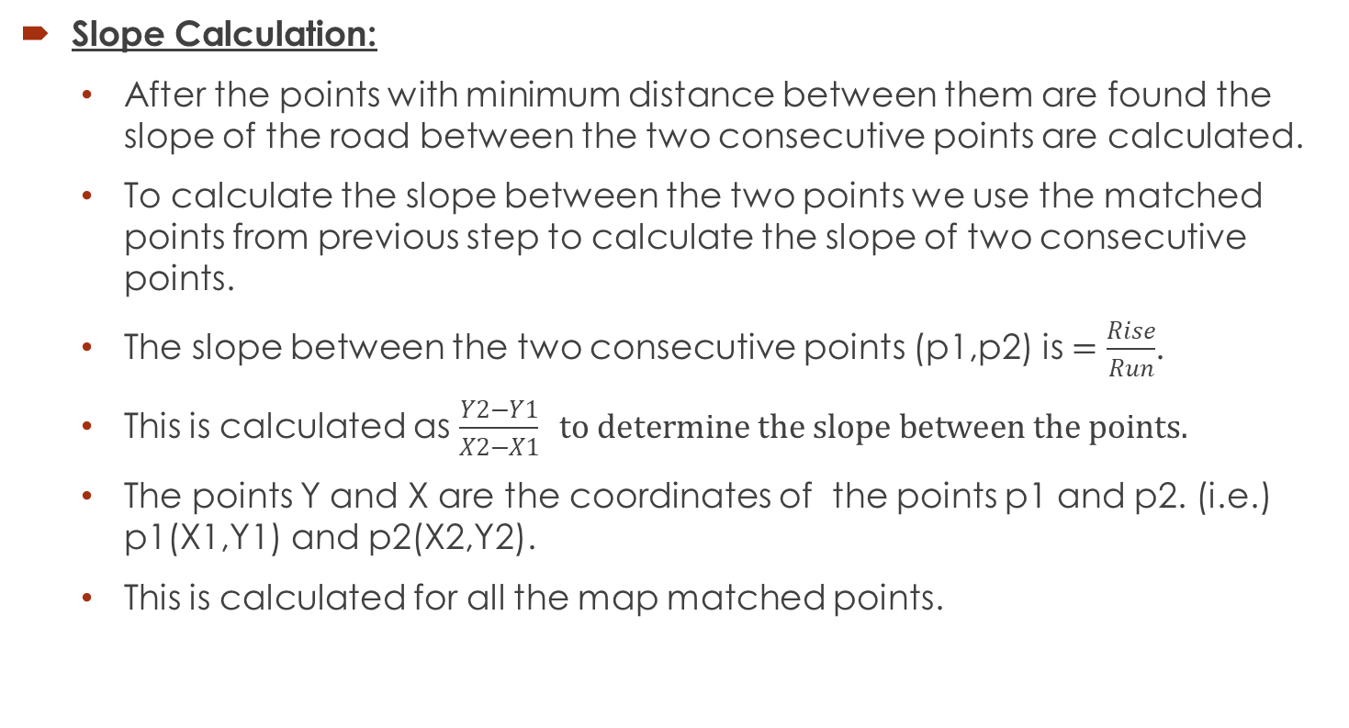
Approach
Slope Calculation:
After the points with minimum distance between them are found the slope of the road between the two consecutive points are calculated.
To calculate the slope between the two points we use the matched points from previous step to calculate the slope of two consecutive points.
The slope between the two consecutive points (p1,p2) is $=\frac{Rise}{Run}$.
This is calculated as$\frac{Y2−Y1}{X2−X1} to determine the slope between the points.$
The points Y and X are the coordinates of the points p1 and p2. (i.e.) p1(X1,Y1) and p2(X2,Y2).
This is calculated for all the map matched points.

Slide 7
Approach
Evaluating the derived road slope wit the surveyed road slope:
Average of slope is calculated for each link data.
This slope is then compared with the slope we calculated in previous step.

Slide 8
Result
The source code is present in five (.java) files with the instructions to run the code in Readme file.
There are two output files.
First file contains the map matched points along with the calculated slope.
Second file contains the slope evaluation.

Slide 9
References:
Guest lecture notes by Dr. Bo Xu
“An Interactive Voting-based Map Matching Algorithm” Yu Zheng, MS Research
“Map-Matching for Low-Sampling-Rate GPS Trajectories” Yu Zheng, MS Research

Slide 10
Thank you

